Slide 1
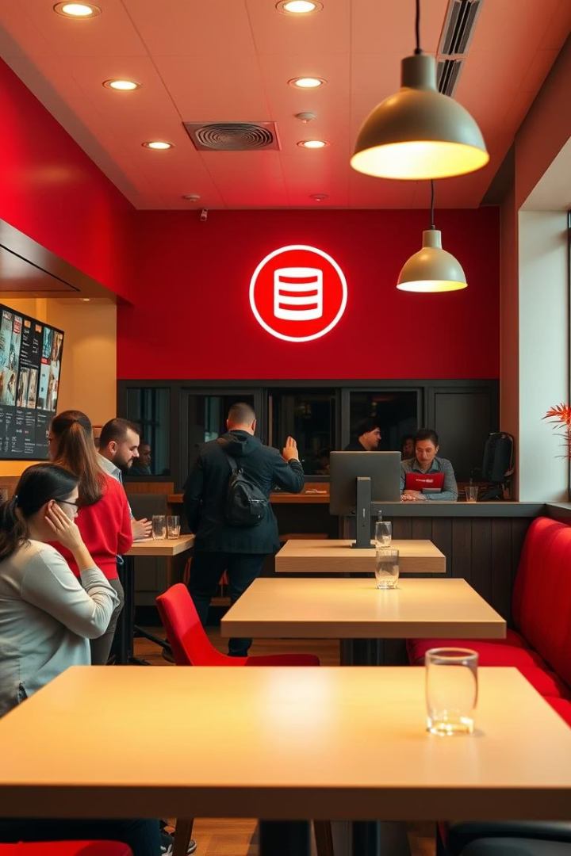
Cafe Management System: A Database Project
Presented by Muhammad Ansab Saddique (241827) and Sayed Shadan Raza (249111).

Slide 2
Project Overview
This project designs a comprehensive database system for cafe management. It covers orders, menu, staff, inventory, and payments. The system is developed using SQL Server for robust data handling.
Core Functionality
Resource Tracking
Technology Stack
Manages key cafe operations including order processing and menu administration.
Efficiently tracks staff information, inventory levels, and payment transactions.
Implemented using SQL Server for a powerful and scalable database solution.

Slide 3
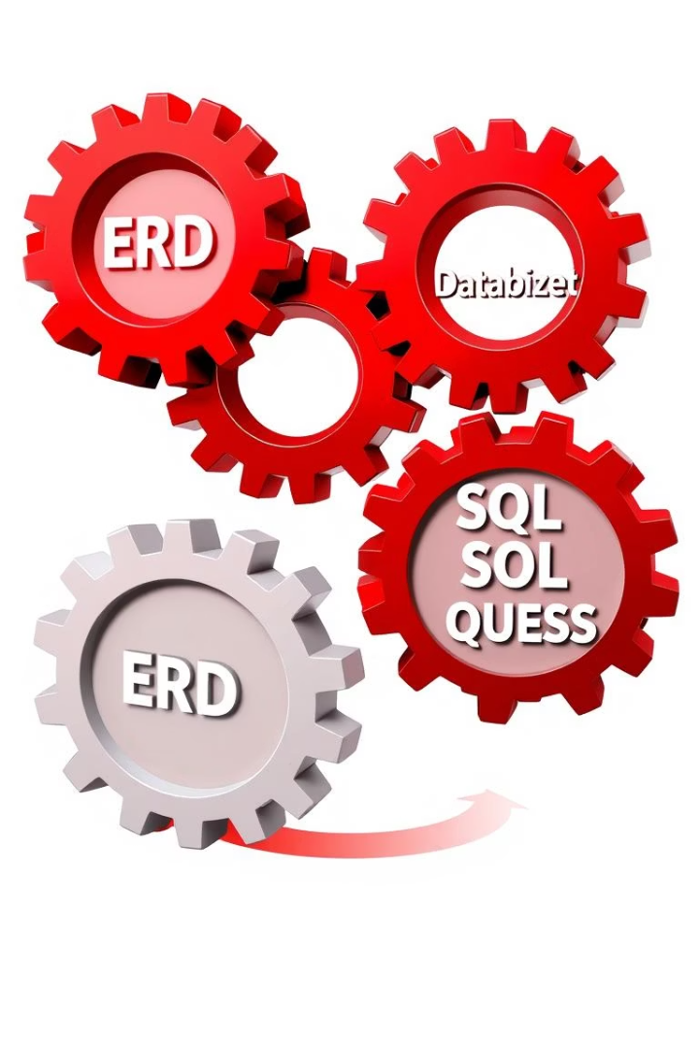
Project Objectives
The primary goals involve applying database modeling and normalization principles. We aim to master SQL querying and consider future frontend integration.
1
ERD/EERD Modeling
Apply advanced entity-relationship diagramming techniques.
2
3NF Normalization
Achieve Third Normal Form for data integrity.
3
SQL Query Execution
Develop and execute complex SQL queries effectively.
4
Frontend Integration
Explore optional integration with a user interface.

Slide 4
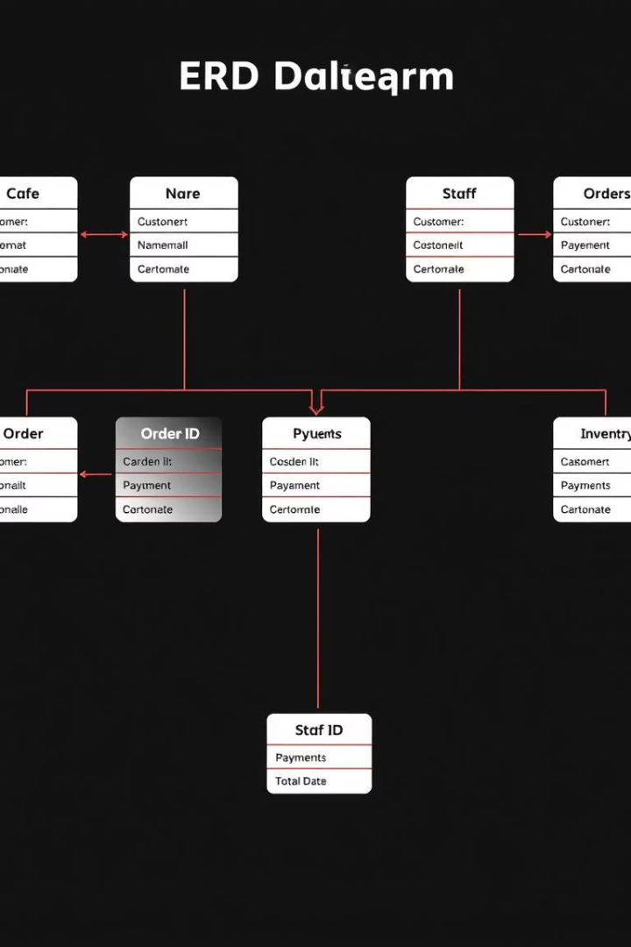
Entity-Relationship Diagram (ERD)
The ERD illustrates relationships between critical entities. These include cafes, customers, staff, orders, payments, reviews, and inventory. This design ensures structured data flow.
Core Entities
Transactional Data
Includes Cafes, Customers, and Staff.
Manages Orders and Payments.
Operational Data
Covers Reviews and Inventory.

Slide 5



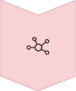
Normalization Process
Normalization progresses through First, Second, and Third Normal Forms. This process eliminates data redundancy and improves data integrity. It ensures each piece of data is stored efficiently.
First Normal Form (1NF)
Ensures all attribute values are atomic.
Second Normal Form (2NF)
Removes partial dependencies on primary keys.
Third Normal Form (3NF)
Eliminates transitive dependencies, separating repeating fields like roles and item names into distinct tables.

Slide 6







Key Database Tables
The system comprises several essential tables, each serving a specific function. These tables work together to support all cafe operations. They form the backbone of the database structure.
Cafes
Customers
Orders
Menu Items
Staff
Payments
Reviews
Inventory

Slide 7
Sample SQL Queries
These examples demonstrate basic data retrieval and aggregation. They showcase how to access and summarize information. The queries illustrate practical database interactions.
SELECT * FROM orders WHERE cafe_id = 1;
SELECT method, SUM(amount) FROM payments GROUP BY method;
SELECT name FROM staff WHERE hire_date > '2024-01-01';
These queries enable efficient data management. They allow for targeted data extraction and summarized financial insights.

Slide 8
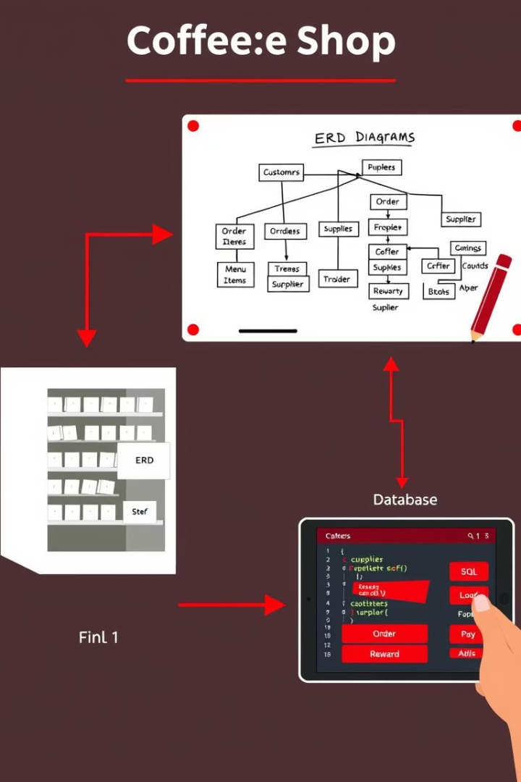
Conclusion & Future Work
We successfully applied SQL Server database design principles. Normalization and ERD concepts were thoroughly implemented. The optional frontend integration remains a future development goal.
SQL Server Mastery
Gained proficiency in database design.
Normalization Applied
Successfully implemented database normalization.
ERD/EERD Concepts
Solidified understanding of modeling concepts.
Frontend Goal
Future development includes optional frontend.

Slide 9
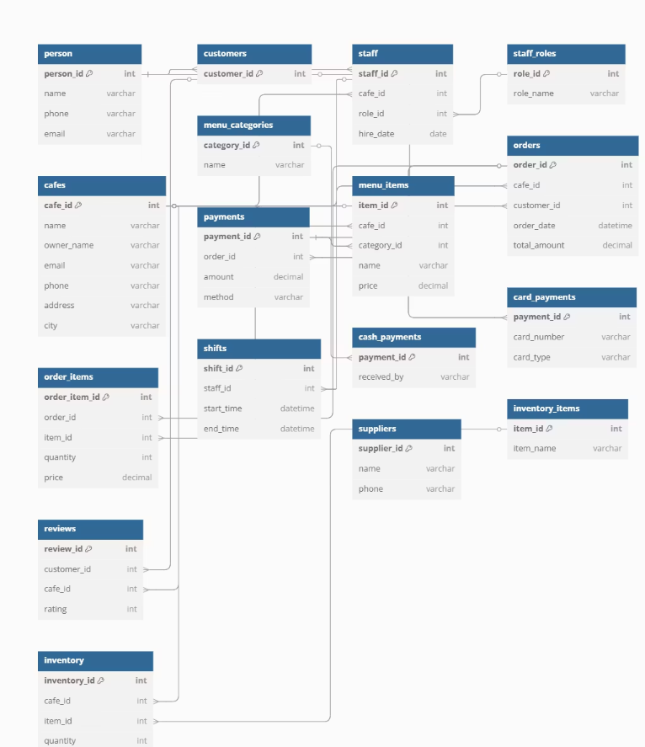
This Enhanced ERD (EERD) represents a fully normalized relational database for managing various aspects of a cafe business. It includes generalization, specialization, and strong relationships between entities.

